Slide 1
Organizing function

Slide 2
Contents
Concept and principles of organizing
Approaches to organizing – Classical, behavioral and contingency
Process of structuring an organization
Departmentalization- meaning and types
Delegation of authority – meaning, features, advantages and barriers
Centralization and decentralization – Meaning, advantages and dis-advantages
Concept of organic and mechanistic views of organization
Types of modern organizational structures- matrix, team and network

Slide 3
Concept
Organizing is an important function of management. Planning sets the desired end results whereas organizing makes further preparation to achieve that result by identifying the detailed activities to be performed and classifying them into manageable units and establishing productive relationships among various positions.
In simple words, organizing is the orderly arrangement of resources and activities to accomplish something. For this, managers are required to
Identify the jobs/activities to be performed (job design)
Classify the jobs/activities (departmentation)
Create positions and determine ‘span of control’ and chain of command (differentiation)
Delegate authority to different positions simultaneously or as and when required
Ensure appropriately coordination among people and units (integration)
According to Louis A. Allen “organizing is the process of identifying and grouping the work to be performed, defining and delegating responsibility and authority, and establishing relationship for the purpose of enabling people to work most effectively together in accomplishing objectives”
To sum up, organizing/organizational design involves the efforts of determination and arrangement of tasks/jobs, positions, authority, responsibility and relationships as a further preparation to put plans into action and then into results.

Slide 4
Process of structuring an organization/organizing process
Organizing is a continuous process and it involves a series of activities. The following are the steps of organizing process
Division of work: It is a process of breaking complex works into small and manageable units. It helps the people to concentrate their work on limited activities but not for the whole activity. Individuals can easily understand their work and organizational expectations from them. It increases specialization of work and helps to avoid duplication of efforts. This increases the production and decreases the time consumption.
Grouping of work: At first the organization determines the specific goals. After defining the goals, it will now group the whole organization into different departments and subsections. All the departments perform their work to achieve the specific goals of the organization. Thus, grouping of work is the process of dividing the work into different departments as per their capacity.
Determining the span of control (horizontal differentiation) and chain of command (vertical differentiation): Another important consideration in designing an organization structure is to determine the number of immediate subordinates each manager should have (span of control) and the number of hierarchies in an organization structure (chain of command). No single number can be prescribed which would apply to all cases and circumstances; rather it varies from case to case or situation to situation. There should be, in fact appropriate balance between span of control and chain of command. Keeping the number of people constant, span of control increases with the decrease in chain of command and vice versa. The span of control should neither be too wide/large nor too narrow/ small in order to ensure effective supervision and economy in operation. Likewise, chain of command should also be neither too short nor too long. Particularly, if it is too long, communication may be slow and distorted. If it is too short, span of control increase and effective supervision, control and coordination cannot be ensured.

Slide 5
Cont…
Delegation of authority: No individual can fulfill any responsibilities without sufficient authorities. An organization can only run properly if there is a balance between the authority and responsibility. A manager must delegate the authority to the sub-ordinates in accordance with their responsibilities. This brings confidence to the individuals and they can perform any tasks easily and on time.
Coordination of work: There must be proper coordination of work among all departments and all the staffs to develop a feeling of group effort and team spirit among them. Proper coordination is only possible where there is efficient communication between them. An organization must have open communication. Managers should communicate with their sub-ordinates for proper guidance and control. Similarly, they should communicate with the colleagues and other departments to know how the work is being done etc. proper communication is essential at all levels and all departments.

Slide 6
Principles of organizing
Management thinkers have laid down certain statements from time to time which provide guidelines in organizing process are called principles of organizing. They are in fact the characteristics of a sound, healthy, simple and flexible organization. Some of the well-established principles of organizing/organization are as follows:
Clarity of objectives: An organization is a mechanism to achieve certain goals or objectives. The objectives of an organization play an important role in determining the type of structure which should be developed so that the objectives can be achieved. Therefore, objectives must be clearly defined for the entire department, for each department and even for each small unit. Moreover, there must be unity of all objectives so that all the efforts can be directed towards the set goals.
Unity of command: No one in the organization should report to more than one line supervisor. Everyone in the organization should know to whom he/she reports and who reports to him/her. Stated simply, everyone should have only one boss. Receiving directions form severs superiors may result in confusion, chaos, conflict and lack of action.
Unity of direction: According to this principle, a group of activities that have a common goal should be managed by one person and should have single plan. There should be one head and one plan for a unit to achieve same or common objectives.
Division of work: According to this principle, there should be proper division of work in the organization so that every person is confined to the performance of a single job. As far as possible, the nature of job should match the skill and abilities specialization which ultimately leads to efficiency and quality.
Chain of command/ scalar principle: There must be clear and unbroken line of authority running from top to bottom of the organization. From the chief executive, a line of authority may proceed to departmental managers, to supervisors or foremen and finally to workers. This is also known as scalar organization.

Slide 7
Cont…
Span of supervision/ control: The term ‘span of supervision’ means the number of employees a manager can directly supervise or control. According to this principle, no manager should be required to supervise more subordinates than he can effectively manage and supervise. Several factors affect the span of control such as the availability of time to manager, ability of manager, nature of work to be supervised, qualification and competence of employees, geographic dispersion of working units etc.
Communication: A good communication network is essential for the smooth flow of information and understanding and for effective performance of jobs. For this, two way communication channels should be established, i.e. from top to bottom and vice versa. The manager should always try to avoid blocks in communication.
Authority and responsibility: Responsibility should always be coupled with corresponding authority. It implies that adequate authority should also be delegated to the subordinates along with responsibilities, for carrying out the jobs assigned to them. For instance, if a supervisor is responsible for the quality of his department, he should have the right to train, guide and punish the workers under him.
Definition of jobs: According to his principle, the job of every position in an organization should be clearly defined. There should be a clear description for every position in regard to the duties, responsibilities, authorities and its relationships with other positions. This is helpful in avoiding overlapping of functions and brings harmonious relation among department, sections and individuals.

Slide 8
Cont…
Flexibility: The organization structure should be flexible so that it can be easily and economically adapted to the changing environment including technological innovations. Flexibility protects organization from serious effects. So the organization structure should permit expansion and contraction without disrupting basic activities.
Balance: There should be appropriate balance between the various aspects of organization. Balance should be maintained between centralization and decentralization; authority and responsibility; and span of control and chain of command. Note that if the span of control is increased, chain of command will be shortened and vice versa.

Slide 9
Approaches to Organizing
Various approaches have been developed for organizing. The common approach to organizing are discussed below:
Classical Approach.
Behavioral Approach.
Contingency Approach.

Slide 10
Approaches to Organizing
Classical Approach.
The classical theory includes three different approaches to organizing:
Scientific Management.
Administrative Management.
Bureaucratic theory.

Slide 11
Approaches to Organizing
Behavioral Approach
The classical theory includes three different approaches to organizing:
Abraham Maslow.
Douglas Mc Gregor.
Frederick Herzberg.

Slide 12
Approaches to Organizing
Contingency Approach.
According to this approach, the manager must understand the uniqueness and complexity of each situation.
Contingency approach to organizing is also known as situational or practical approach to management.

Slide 13
Departmentalization
Departmentalization is the process of logical grouping the similar nature functions into manageable units for the purpose of overall coordination of organizational resources.
It creates separate units with some independent responsibilities to departmental managers who in turn improve their working efficiency and effectiveness.

Slide 14
Types of Departmentalization
Departmentalization by Functions.
Departmentalization by Product/Service.
Departmentalization by Customers.
Departmentalization by Territory.
Departmentalization by Process.
Departmentalization by Time.

Slide 15
Types of Departmentalization
Departmentalization by Functions.
General Manager
Product ion
Department
Finance
Department
Marketing
Department
Personnel
Department

Slide 16
Types of Departmentalization
b) Departmentalization by Product/Service.
General Manager
Publication
Department
Noodles
Department
Electronic
Department
Beverage
Department
Production
Department
Finance
Department
Marketing
Department
Personnel
Department

Slide 17
Types of Departmentalization
c) Departmentalization by Customers.
General Manager
Industrial Product
Buyers
Consumer Product
Buyers
Production
Department
Finance
Department
Marketing
Department
Personnel
Department

Slide 18
Types of Departmentalization
d) Departmentalization by Territory.
General Manager
Eastern
Region
Central
Region
Western
Region
Mid-Western
Region
Far-Western
Region
Production
Department
Finance
Department
Marketing
Department
Personnel
Department

Slide 19
Types of Departmentalization
e) Departmentalization by Process.
General Manager
Ginning
Department
Spinning
Department
Weaving
Department
Dyeing
Department
Finishing
Department

Slide 20
Types of Departmentalization
f) Departmentalization by Time.
General Manager
Morning
Shift
Day Shift
Night
Department
Production
Department
Finance
Department
Marketing
Department
Personnel
Department

Slide 21
Delegation of authority
Managers cannot perform all the work by themselves. They will have to provide responsibilities and authorities to their subordinated for the smooth functioning of the organization. In simple words, managers share their work load to the subordinates. Thus, we can say that delegation is the process by which managers assign a portion of their total work load to others.
According to Freeman and Gilbert “Delegation is the act of assigning formal authority and responsibility for completion of specific activities to a subordinate”. Therefore, delegation is a process of assigning work to others and providing them essential authority to complete the task effectively.
Features:
Total authority of a manager cannot be delegated. Delegation of authority is a process of providing a portion of authority from the managers to their sub-ordinates.
A manager can only delegate that authority that he possess. He cannot delegate other’s authority.
Delegation of authority is not a permanent process. A manager has a right to recall the authority.
The superior who delegates the authority will also be liable for the actions of his subordinates during the performance of a task.
Delegation of authority has to be done only for organizational purpose but not for the personal purpose.

Slide 22
Advantages
Delegation increases the responsibilities of a manager. A manager will have more work experience and get exposed to newer and difficult tasks.
Reduced workload to the top management
Subordinates feel motivated to the work. They will increase their self confidence and even take good initiatives for the work completion.
Better decisions can be made because decision makers are close to the operation process and they have a clearer view of the facts.
Speeds up decision making process
Helps in training and development of managers and staffs. They can gain new knowledge and experience. They can be used in future decision making.
Facilitates growth and expansion of business

Slide 23
Cont…
Barriers to delegation
Employees don’t like to bear extra responsibilities. They want their superiors to make decisions.
Some managers don’t like to delegate the authority because they lack confidence and trust in lower level employees.
Managers become confused with authority can be delegated and which cannot be delegated.
Managers may feel that delegation of authority increases skill of subordinates. This can cause a problem of their own advancement.
Employees may demand for extra remuneration (money) for extra work load.
Delegation will be useless if subordinates are unskilled.

Slide 24
Centralization
The process of systematically retaining power and authority in the hands of higher level managers is call centralization. The sole decision making authority is in the hands of higher level managers. The role of the subordinates is reduced and they cannot generate any creative thoughts and ideas. They only have to follow the orders. The process of centralization helps to make quicker decisions. The process is only suitable when the size of an organization smaller, but as the size goes on increasing, centralization will be impractical. Centralized structure works well in a very stable and predictable industry/ sector and environment.
Advantages
Top level decisions are good in extreme conditions
Organization structure becomes simple. There will be only two levels as managerial and operating level
Quick decisions can be provided in emergent situations
Economy in operation
Suitable for small firms
Close monitoring
Suitable where subordinates are incompetent and require strict control.

Slide 25
Cont…
Disadvantages of centralization
Delay in decision making
Low morale, motivation and job satisfaction
Difficulty in managing branches located at different locations
Unsuitable in unstable environments
Burden to top executives

Slide 26
Decentralization
Decentralization of authority refers to the dispersal of decision making power to the lower levels of management. According to Louis A. Allen. “Decentralization refers to the systematic effort to delegate to the lowest levels all authority except that which can be exercised at central points”. Thus, it pushes down the decision-making power to managers who are closest to action.
Advantages
Reduction in workload to top level managers
Ensures specialization
Quick and better decisions
Improves motivation and morale
Facilitates expansion and growth
Efficient running of branches
Disadvantages
Increases administrative cost
Problem of coordination
Irrelevant for small organizations
Lead to inconsistencies
Difficulty in emergency situations
Unsuitable if the availability of competent human resource is limited

Slide 27
Concept of organic and mechanistic views of organization
Basis of difference | Mechanistic organization | Organic organization
Specialization | Focuses of individual specialization on one task | Joint specialization as employees work together and coordinate tasks
Hierarchy structure | Well defined hierarchy of authority | Integration of task forces and teams in the hierarchy
Decision | Centralized decision making | Decentralized decision making
Communication | Vertical and written means | Lateral and normally verbal means
Operating procedure | Standard work procedures and strict rules and regulations | Unpredictable work process and mutual adjustment
Status | Formal status in organization based on size of empire | Informal status based on perceived brilliance
Concept | Organization is a network of positions corresponding to tasks. Typically each person corresponds to one task | Organization is network of persons or teams. People work in different capacities simultaneously and over time

Slide 28
Types of modern organizational structures- matrix, team and network
Matrix structure: The foundation of matrix is a set of functional departments. In this organization design, functional units are headed by vice presidents of engineering, production, finance, marketing etc. Each of the manager has different subordinates. There are project managers who head the project group and consist of workers from functional departments. i.e. there is multiple command structure. Project group is assigned with a new project say new product development. Representatives are chosen form different functional departments. For organizations having multiple products or project, it makes appropriate balance by giving appropriate weightage to both project/.products and functions.
Advantages
Enhances flexibility because teams are created, redefined and dissolved as needed.
High motivation in team members due to decision making power.
Employees can learn new skills
Organization can have full utilization of human resources
Organization can have full utilization of human resources
Enhances cooperation as they develop a bridge between a team and functional unit.
Useful vehicle for decentralization
Disadvantages
Reporting difficulties for employees
Managers begin to feel that they have unlimited freedom
Time consuming in group decision making.
Violation of unity of command.

Slide 29
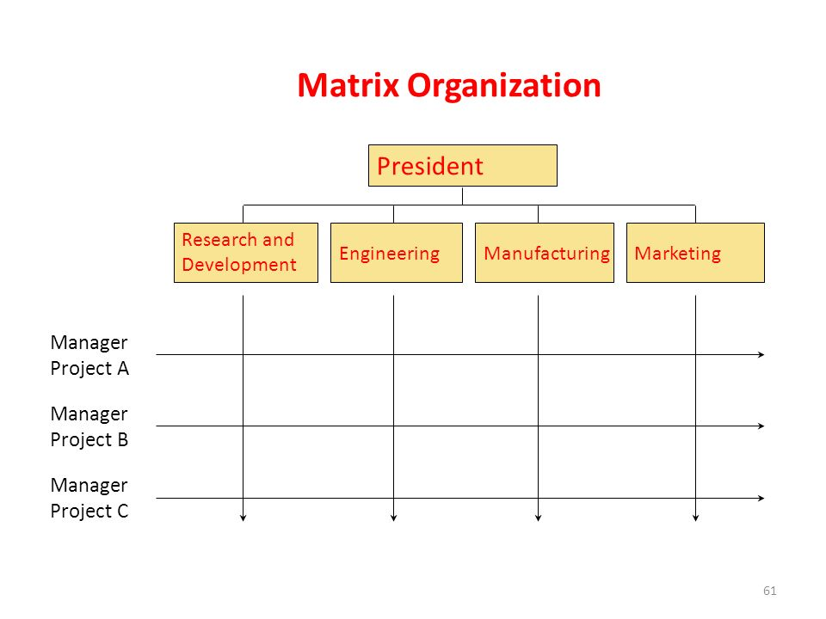

Slide 30
Cont…
2. Virtual organization: Typically a small, core organization that outsources major business functions is called virtual organization (sometimes called network, or modular, organization). In structural terms, the virtual organization is highly centralized, with little or no departmentalization, maximum flexibility, innovative and little money. No control is drawback.
These virtual organizations have created networks of relationships that allow them to contract out manufacturing, distributing, marketing, or any other business functions that management feels that others can do better or more cheaply (outsources).

Slide 31
Cont…
Virtual organization is an organization in which management outsources all of the primary functions of the business. The core of the business organization is a small group of executives whose job is to oversee directly any activities that are done in-house and to coordinate relationships with the other organizations that manufacture, distribute, and perform other crucial functions for the virtual organization.
In essence, managers in virtual structures spend most of their time coordinating and controlling external relations, typically by way of computer-network links (Robbins and Judge, 2009).

Slide 32
Cont…
5. Team structure: Some writers even call it lateral structure because it relies heavily on lateral communication while others call it cluster structure because it is composed of cluster of teams. Such type of organizational structure is possible only after the process of decentralization followed with empowerment. The structure consists of self-directed work teams rather than individuals. The members in a team have a specific purpose as making a specific product or serving a specific client group. Teams have a very flat hierarchy usually with no more than two or three management levels. The members in a team are self-motivated and self-directed. This increases the flexibility in a team. There is open communication in the team.
Types
Problem solving teams
Self-managed work teams
Cross-functional work teams
Virtual teams

Slide 33
Cont…
Advantages
Lower costs (Reduced hierarchy)
Open communication
Increase flexibility
Quick decision making
Reduced delays and errors
Disadvantages
Higher costs (skill trainings)
Higher coordination essential in early days
Increase ambiguity in the roles of employees
More stress for leaders (conflicts, reduced power etc.)

Slide 34
Extra

Slide 35
Types of teams
Teams can do variety of things. They can make products, provide service, negotiate deals, coordinates projects, offer advice, and make decisions. Four most common types of teams is found out in an organization: Problem-solving teams, self-managed work teams, cross-functional teams, and virtual teams.
1. Problem-solving Teams: Teams were typically composed of 5 to 12 hourly employees from the same department who met for a few hours each week to discuss ways of improving quality, efficiency, and the work environment. We call these problem-solving teams (Robbins and Judge, 2009).
In this teams members share ideas or offer suggestions on how work processes and methods can be improved; they rarely have the authority to unilaterally implement any of their suggested actions. One of the most practiced applications of problem-solving teams during the 1908s was quality circles. It comprises 8 to 10 employees. They discuss their quality problems, investigate causes of the problems, recommend solutions, and take corrective actions.

Slide 36
Cont…
2. Self-Managed Work Teams: Although problem-solving teams involve employees in decisions, they “only” make recommendations. Some organization enjoys the not only solve problems but implement solutions and take responsibility for outcomes.
Self-managed work teams are groups of employees 10 to 15 in number, who perform highly related jobs and take on many of the responsibilities of their former supervisors. These tasks involves planning, scheduling work, assigning tasks, making operating decisions, taking actions on problems, and working with suppliers and customers. Fully self-managed work teams even select their own members and have the members evaluate each other’s performance. As a result, supervisory function may even be eliminated.

Slide 37
Cont…
3. Cross-Functional teams
These teams are made up of employees from about the same hierarchical level (From production, planning, quality, tooling, design engineering, and information), but from different work areas, who come together to accomplish a task.
In summary, cross-functional teams are an effective means for allowing people from diverse areas within an organization (or even between organizations) to exchange information, develop new ideas, and solve problems, and coordinate complex projects. Their early stages of development are often time - consuming, as members learn to work with diversity and complexity. It takes time to build trust and teamwork, especially among people from different background with different experiences and perspectives.

Slide 38
Cont…
4. Virtual Teams
The previously described types of teams do their work face-to-face. Virtual teams use computer technology to tie together physically dispersed members in order to achieve a common goal. They allow people to collaborate online - using communication links such as wide-area networks, video conferencing, or e-mail – whether they are only a room away or continents apart. Virtual teams are so pervasive, and technology has advanced so far, that it’s probably a bit of a misnomer (Misuse of the word) to call these teams “virtual”. Nearly all teams today do at least some of their work remotely.
They do not meet personally, task oriented, and less social emotions. To be effective that should have (1) trust is established among team members (2) teams progress is monitored closely, and (3) the efforts and products of the virtual team are publicized throughout the organization ( so the team does not become invisible).

